Slide 1
Bootstrap classes
Christopher Harrison
@geektrainer
Content Developer
Microsoft

Slide 2
Bootstrap classes
“Call” Bootstrap components
Three common starting classes
container
Creates a “fixed width” container
container-fluid
Container will always be the width of the browser
jumbotron
Used to create title sections

Slide 3
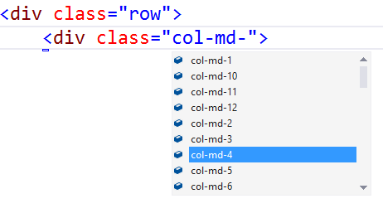
Visual Studio – Class IntelliSense

Slide 4
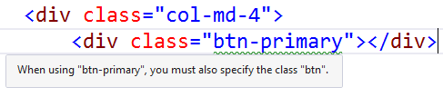
Visual Studio – Missing Class Detection

Slide 5
Bootstrap snippets
Snippets are an “enhanced copy/paste”
Simplify typing out blocks of code
Accessed by:
Right click > Insert Snippet
Ctl-K, Ctl-X
Snippets are available for Bootstrap
GitHub project by Eric Lebetsamer
https://github.com/elebetsamer

Slide 6
Visual Studio Support

